Slide 1
Making Finals not as Bad
By Jonathan Falk, Aaron Rumack and Jesse Schloss

Slide 2


Goal: Create a better finals schedule by
Avoid student conflicts
Prioritize student preferences

Slide 3
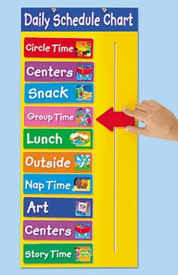

Preprocessing
Read course data from BookHolders API to generate a course schedule
Enroll students in courses via 2-2-1
Erase conflicts in student schedules
Create bad finals schedule via time for one section, conflict for multi section

Slide 4

Conflict Avoidance
Uses Min-Conflicts Algorithm to minimize total number of student conflicts within schedule. A student conflict is defined a student having two finals at the same time.

Slide 5
Preference Optimization
Minimize badness in student schedules while avoiding new conflicts by swapping entire blocks around using a modified Min-Conflicts Algorithm
Slot 1:
Napping 101 Exam
Wines
Slot 1:
Napping 101 Exam
Wines
Slot 2:
Secret Agents 007
Beers
Slot 2:
Secret Agents 007
Beers

Slide 6

Functional?
We hope so! It would require as inputs from the university the following things:
Each students courses
Each students preferences
The master schedule of classes

Slide 7

Innovative?
Absolutely! Most other finals algorithms only take into account conflict minimization, without worrying about student preferences

Slide 8

Impactful?
Definitely! It could help improve finals schedule to make students happier. It could be applied to every college across the country, impacting millions of students.
It could also be generalized to other fields which face similar scheduling decisions.

Slide 9

Complex?
You betcha! Just look at our code

Slide 10

Scalable?
Sure! We optimized all of our algorithms where possible, and with more computing power this algorithm could be run quite quickly. The only bottleneck would be downloading all the information from the client.

Slide 11

Intuitive?
At a high level, yup! The actual implementation gets pretty complex in places, but at a higher level the algorithm is fairly intuitive and simple.

